Slide 1


CODE MAVERICKS

Slide 2
PROBLEM STATEMENT 4
Analysis of FIR using AI/ML for proper Act and Section
BACKGROUND
When complaints are filed, FIRs are recorded with sections of IPC and other acts, but there's a challenge in understanding the multiplicity of acts. This can lead to accusations of applying the wrong or weaker sections of the law. AI can assist by suggesting relevant sections based on the language of the complaint, allowing investigators to probe accordingly.
Solution using NLP
Structured Data Representation
Legal and Regulatory Compliance
Challenges
CCTNS Datasets Not Utilized
Limited use of FIRs available on Rajcop

Slide 3
DESIRED SOLUTION
OCR Functionality
User Flexibility
Standardization
Transparency and Accountability
Compatibility with CCTNS
Law Application Highlighting

Slide 4
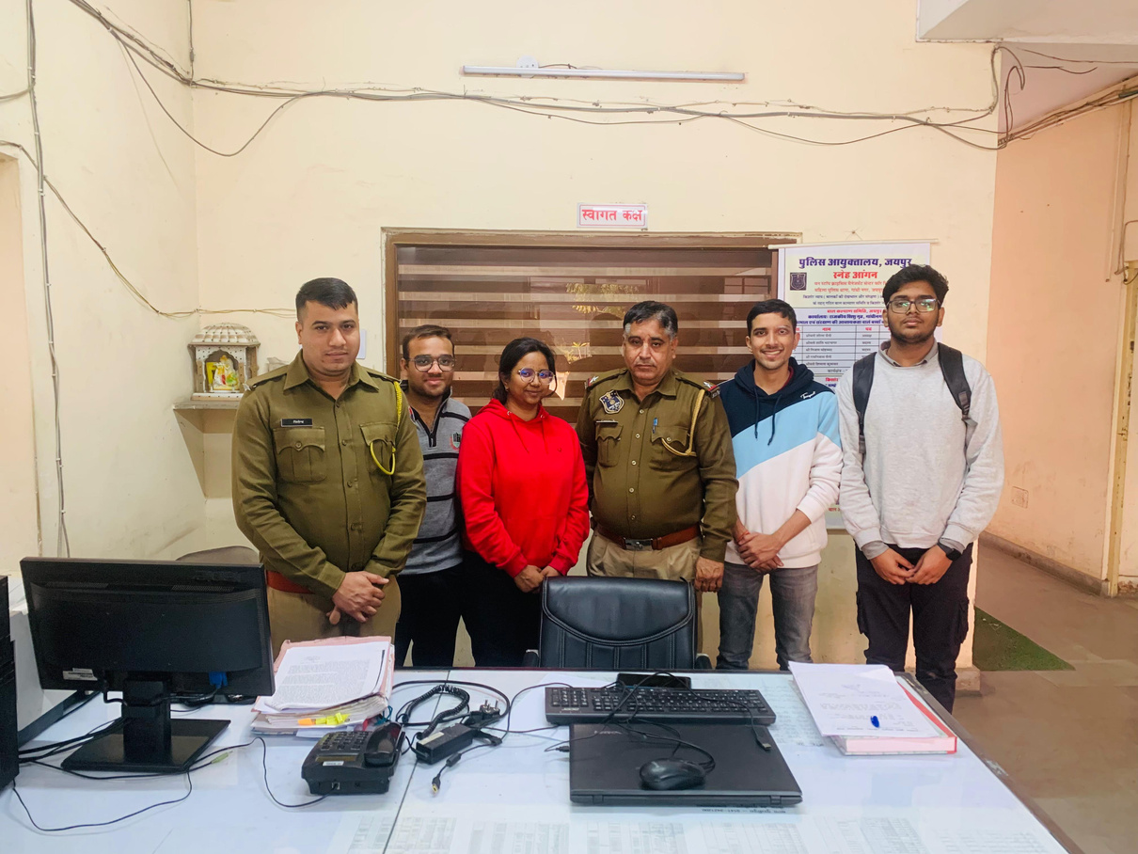
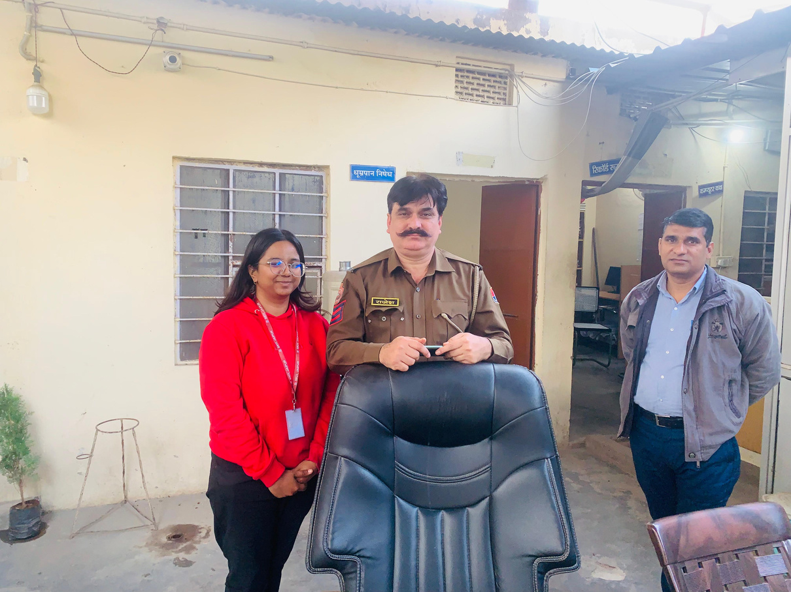
RESEARCH FINDINGS
METHODOLOGY
Detailed insights gathered through police department visits, interviews, and in-depth discussions with POLICE INSPECTORS.
FIR CHARACTERISTICS
Analyzed various aspects including the length, format, and existing practices related to FIR documentation.
USER PREFERENCES
Understanding the demand for AI suggestions with editable options to streamline law enforcement procedures.

Slide 5
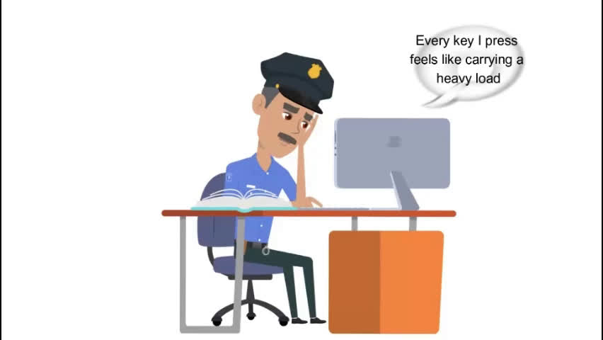
OUR SOLUTION

Slide 6
IMPLEMENTATION TIMELINE
FIR INSIGHT
1
2
3
4
5
6
RESEARCH PHASE
SOLUTION PROPOSAL
TECHNOLOGY STACK
CURRENT PROGRESS
CHALLENGES & CONSIDERATIONS
FUTURE ASPECTS
Police Visits
Interviews
Text Analysis
Knowledge Base
ML Model Training
Integration
Python, Dart, Flutter
NLP Libraries (Roberta, BERT,GPT2)
FlutterFlow, TensorFlow,Pytorch
OCR Implementation
NLP Model Training
UI/UX Development
Personal Records
IPC Database Link
CCTNS Site Integration
Multiplicity Challenge
Act Handling Features
Technology Adaptation

Slide 7
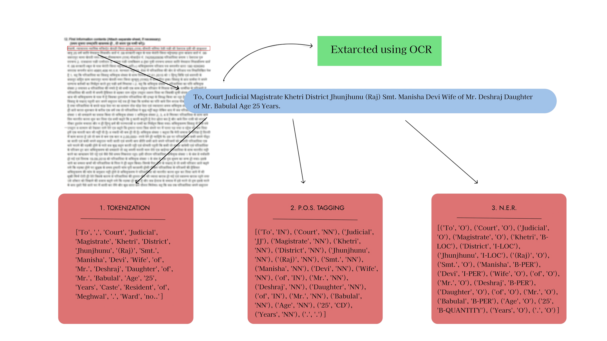
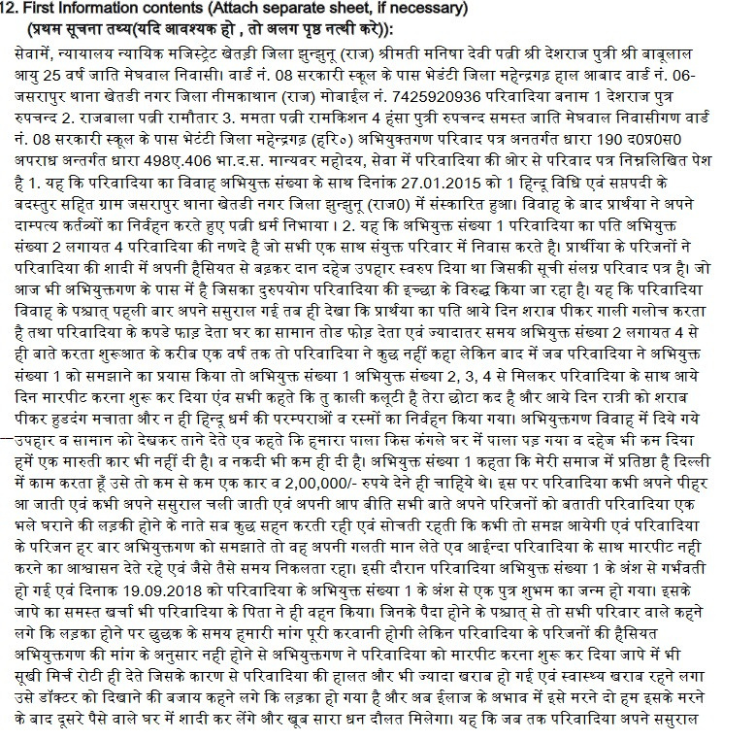
OUR SOLUTION (IMPLEMENTATION )

Slide 8
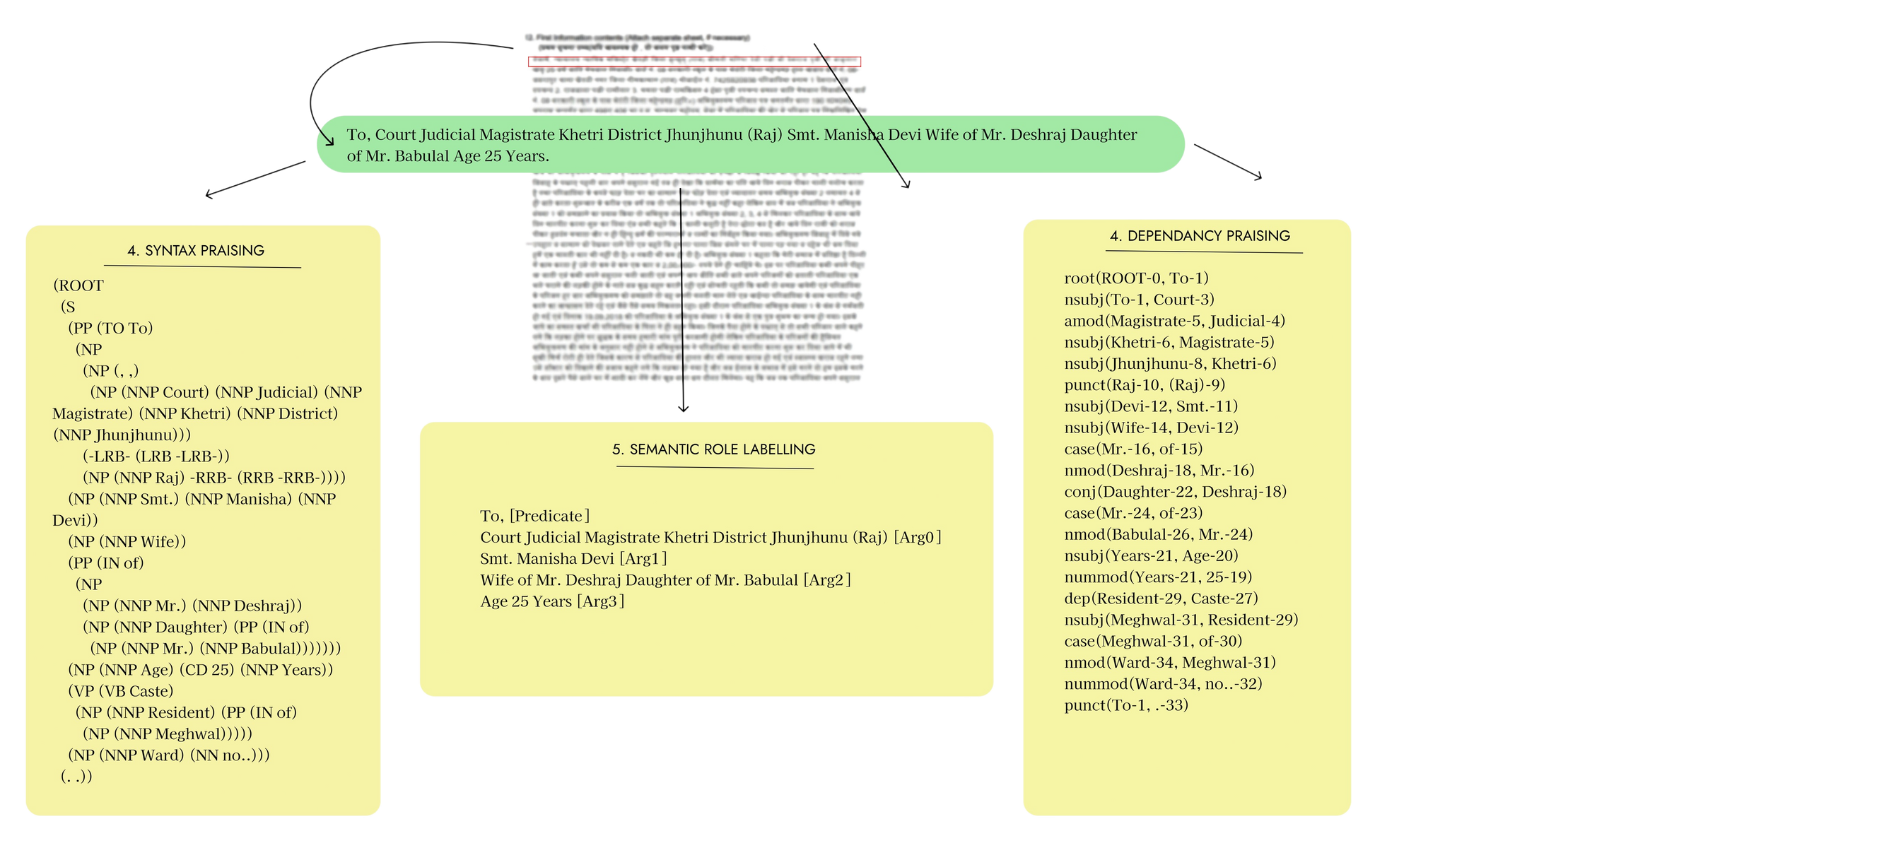
OUR SOLUTION (IMPLEMENTATION )

Slide 9
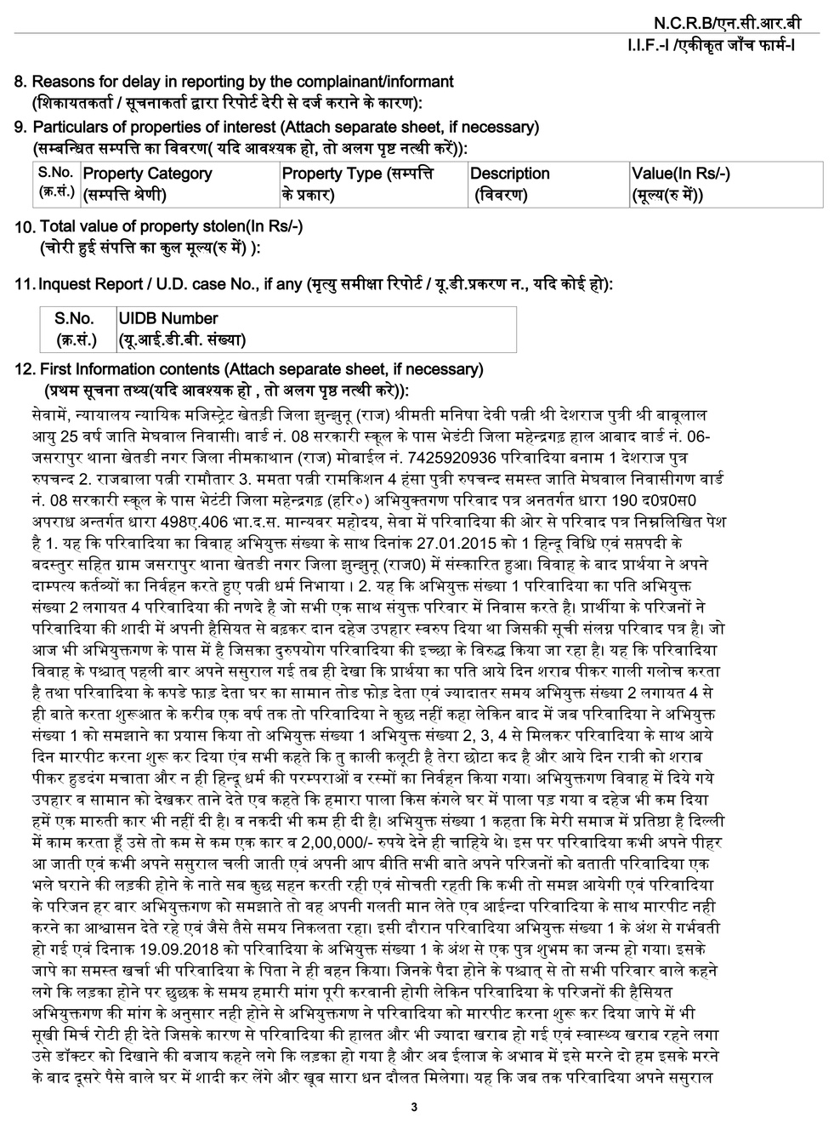
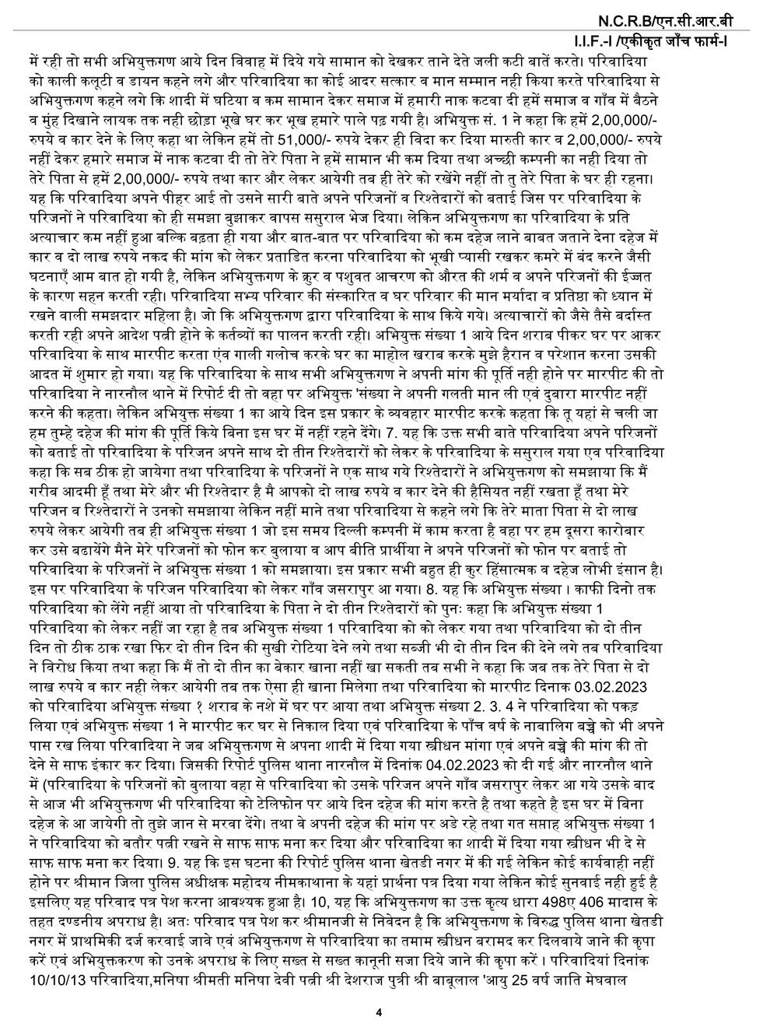
OUR SOLUTION (IMPLEMENTATION )
TEXT GENERATION
20 जुलाई, 2023 को 10:00 बजे, खेतड़ीनगर थाना, झुंझुनू जिला, राजस्थान में थानाधिकारी गोपाल सिंह द्वारा प्राप्त शिकायत के आधार पर एक दहेज उत्पीड़न के मामले का FIR दर्ज किया गया है। महत्वपूर्ण विवरण: जिला: झुंझुनू पुलिस स्टेशन: खेतड़ीनगर वर्ष: 2023 FIR संख्या: अभी तक नहीं प्राप्त FIR दर्ज करने की तारीख और समय: 20 जुलाई, 2023, 10:00 बजे आपराधिक धाराएँ और अधिनियम: दहेज उत्पीड़न अपराध का हुआ: 24 मई, 2019 को शादी के दौरान थाना में सूचना प्राप्त हुई: 20 जुलाई, 2023, 10:00 बजे सूचना प्राप्त करने का प्रकार: लिखित घटना का स्थान: रूडाराम की ढाणी, बडवासी, झुंझुनू शिकायतकर्ता अनिता कुमारी के विवरण: नाम: अनिता कुमारी पिता का नाम: अरुण कुमार जन्मतिथि: (जानकारी नहीं दी गई) UID: (जानकारी नहीं दी गई) पासपोर्ट नंबर: (जानकारी नहीं दी गई) ID विवरण: (जानकारी नहीं दी गई) व्यापार: (जानकारी नहीं दी गई) फ़ोन नंबर: 8763269823 पता: चरण सिंह नगर, खेतड़ी तहसील, झुंझुनू जिला, राजस्थान आपराधिक धाराएँ और अधिनियम: दहेज उत्पीड़न के तहत धारा (जानकारी नहीं दी गई)

Slide 10
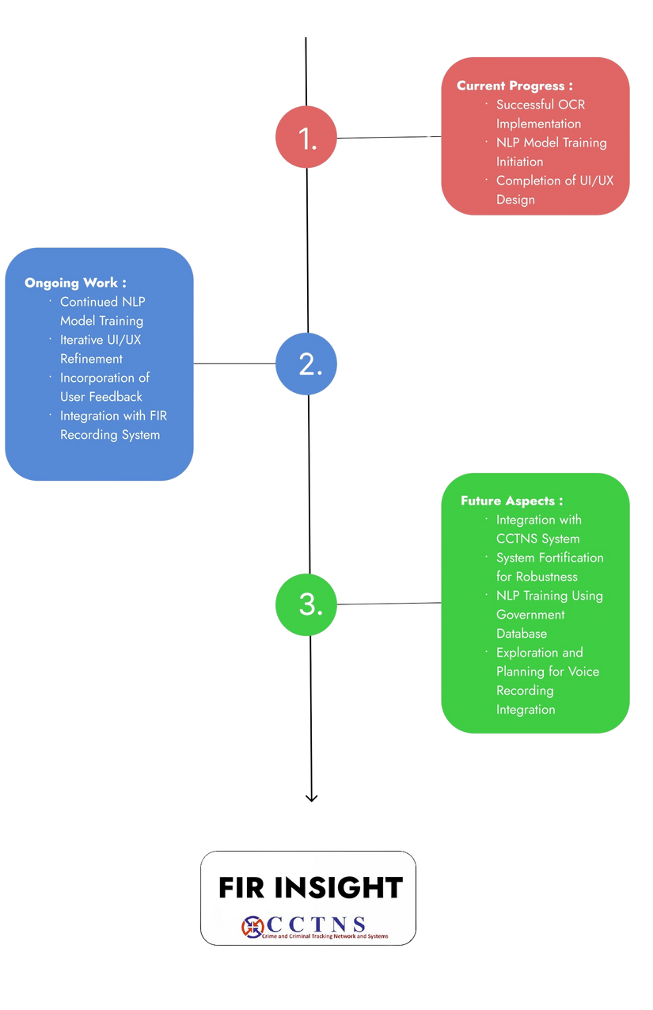
FUTURE RECOMMENDATIONS
1. Integration with CCTNS:
- Enhance collaboration with the CCTNS system to streamline data exchange and improve access to criminal records.
2. System Fortification:
- Strengthen the system architecture to ensure reliability, scalability, and resilience for sustained efficiency.
3. NLP Training with Government Database:
- Refine the NLP model through continuous training using government databases to enhance understanding of legal language nuances.
4. Voice Recording Integration:
- Explore and plan the integration of voice recording capabilities into the FIR analysis system, providing an additional layer of user-friendly input.

Slide 11
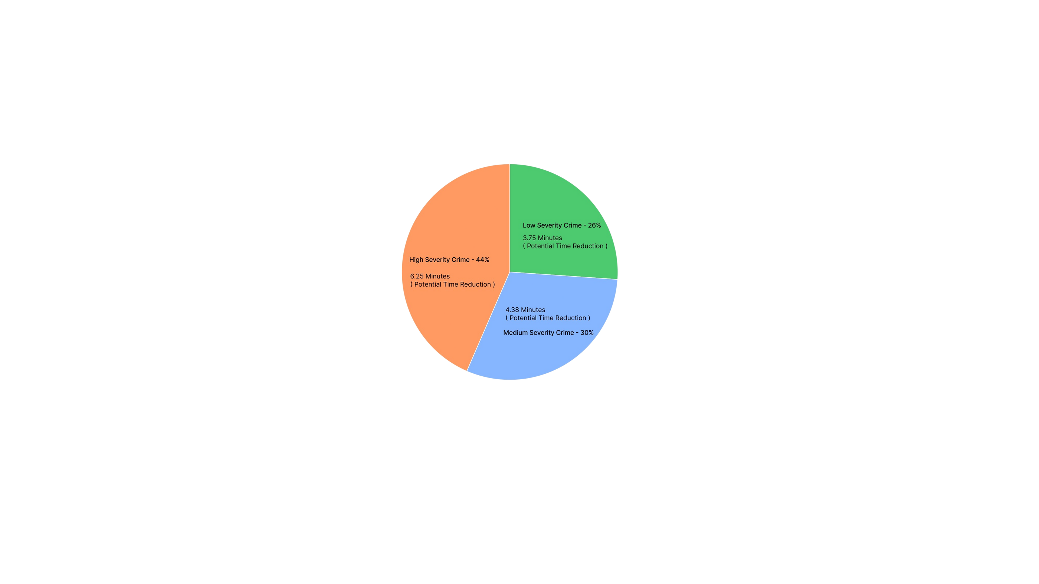
CONCLUSION
1. ENHANCED TIME EFFICIENCY:
OUR SYSTEM SIGNIFICANTLY REDUCES THE TIME TRADITIONALLY SPENT ON FIR WRITING THROUGH:
AUTOMATED DATA EXTRACTION USING OCR TECHNOLOGY.
EFFICIENT TEXT ANALYSIS AND REAL-TIME SUGGESTIONS FROM OUR NLP MODEL.
STREAMLINED ONLINE FIR FILING AND KNOWLEDGE BASE REFERENCE.
2. INFORMED BY GROUND RESEARCH:
OUR USER-CENTRIC APPROACH IS ROOTED IN COMPREHENSIVE GROUND RESEARCH, ENSURING THE SYSTEM ALIGNS WITH THE ACTUAL NEEDS AND PREFERENCES OF POLICE OFFICERS.
INSIGHTS FROM VISITS, INTERVIEWS, AND DISCUSSIONS WITH LAW ENFORCEMENT PROFESSIONALS HAVE BEEN INSTRUMENTAL IN SHAPING A SOLUTION TAILORED TO THEIR WORKFLOW.
3. USER-FRIENDLY INTERFACE:
THE USER-FRIENDLY INTERFACE ALLOWS LAW ENFORCEMENT PROFESSIONALS TO EDIT AND FINALIZE FIR CONTENT EFFICIENTLY, CONTRIBUTING TO A SMOOTHER WORKFLOW.
INCORPORATING SUGGESTIONS AND PREFERENCES GATHERED DURING GROUND RESEARCH ENSURES THE SYSTEM IS INTUITIVE AND MEETS THE PRACTICAL NEEDS OF ITS USERS.
4. ANTICIPATED IMPACT:
WITH THESE ADVANCEMENTS, WE ANTICIPATE A SUBSTANTIAL OVERALL REDUCTION IN THE TIME AND EFFORT INVESTED IN FIR WRITING, CONTRIBUTING TO IMPROVED RESPONSE TIMES AND OPERATIONAL EFFICIENCY.

Slide 12
THANK YOU

